Slide 1

Emerging Food Safety & Security Risk driven by Climate Change
Dr. Michelle Riblet,
Director, Farrelly & Mitchell
Thursday 30th September 2021
Presenter,
Designation
Date

Slide 2
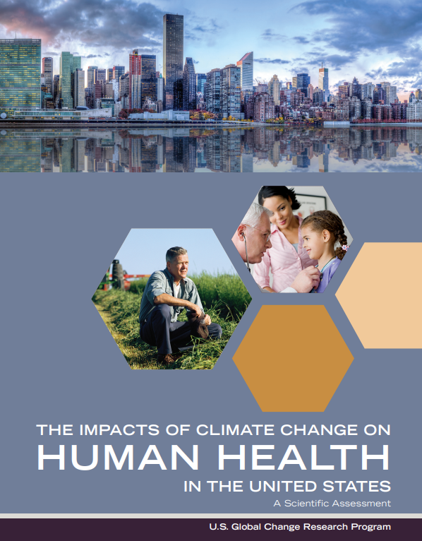
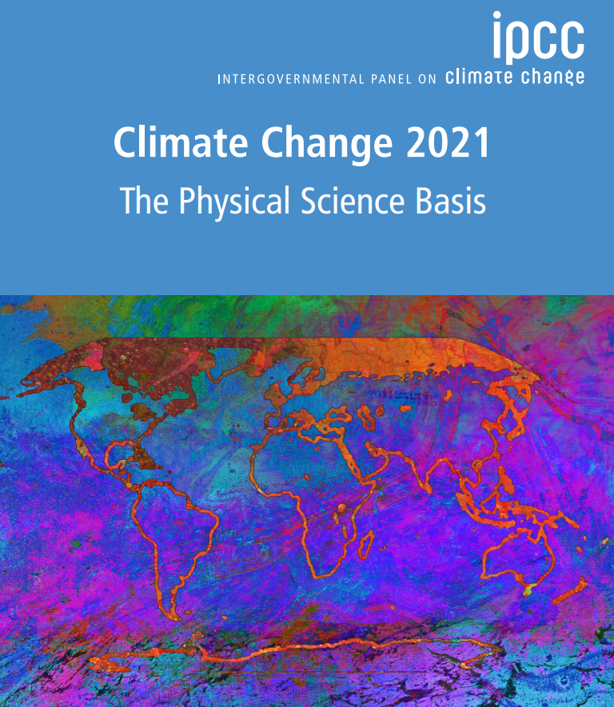
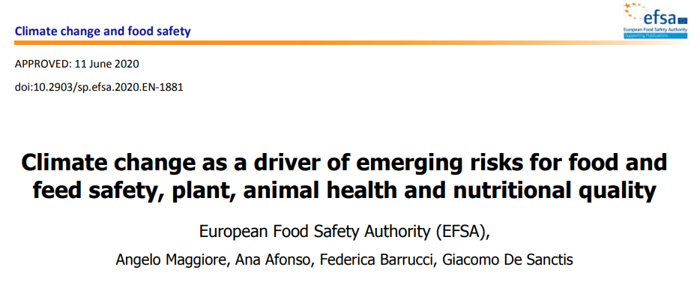
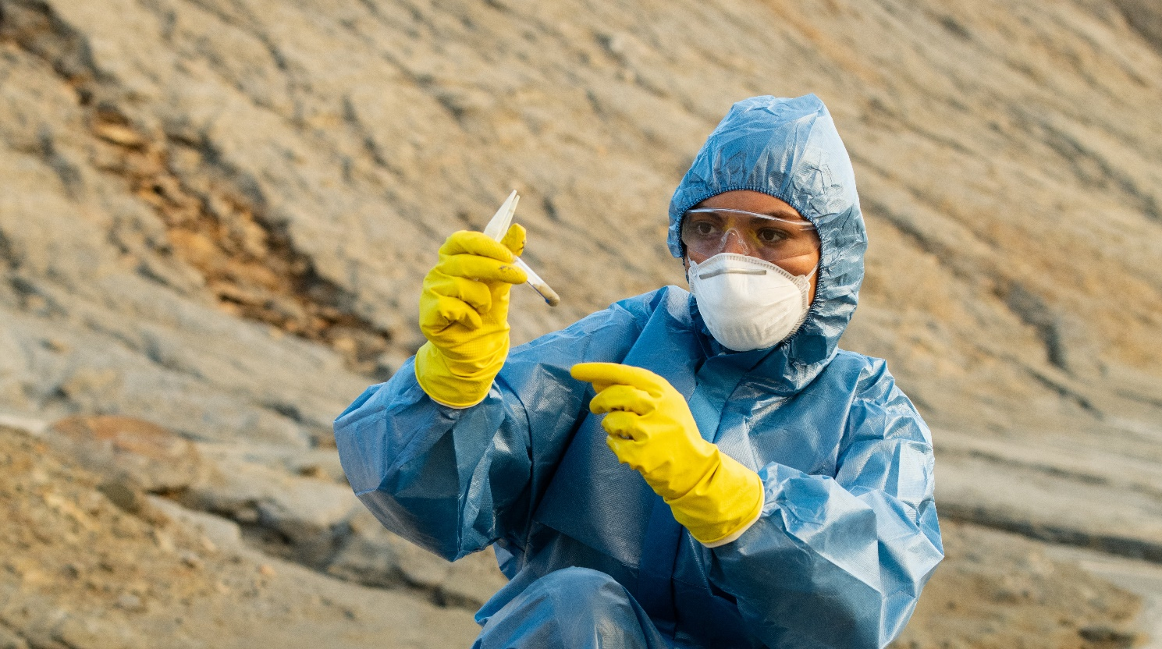
Latest Scientific Research

Slide 3







Complex Interdependent System
Farmers
Climate change
Food safety systems
Processors
Imbalance in System
Food
system
Policy makers
Traders
Compounding and exponential impact on food safety and food security
Nutrition
Food waste/loss

Slide 4




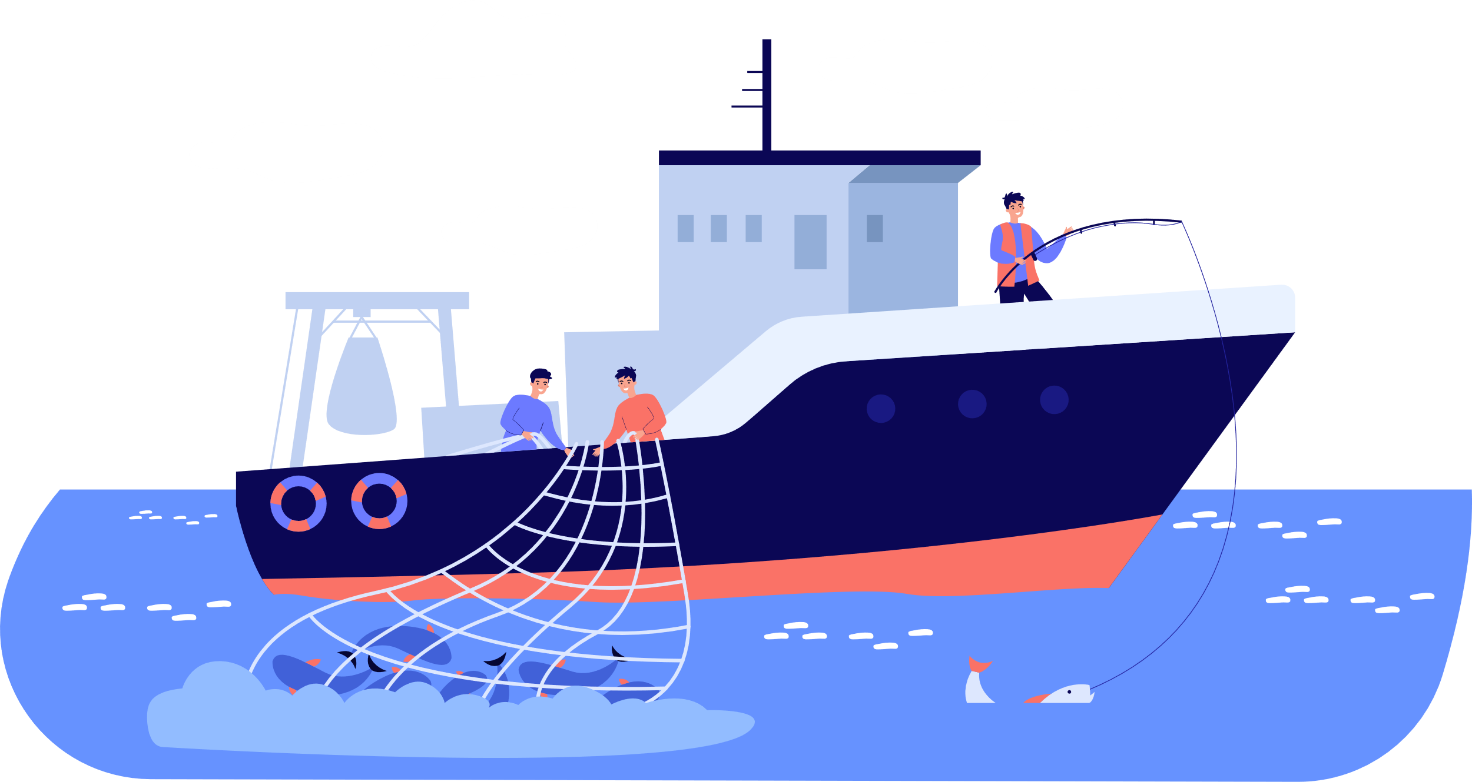












The Potential Interactions of Rising CO₂ and Climate Change on Food System
Temperature and precipitation extremes (like flooding) can increase pathogen load.
Rising carbon dioxide can directly influence nutritional content of foods.
Warmer temperatures can result in greater food spoilage
Extreme climate events can disrupt food distribution
Climate can also alter weed, insect, and fungal populations and increase pesticide use.

Slide 5
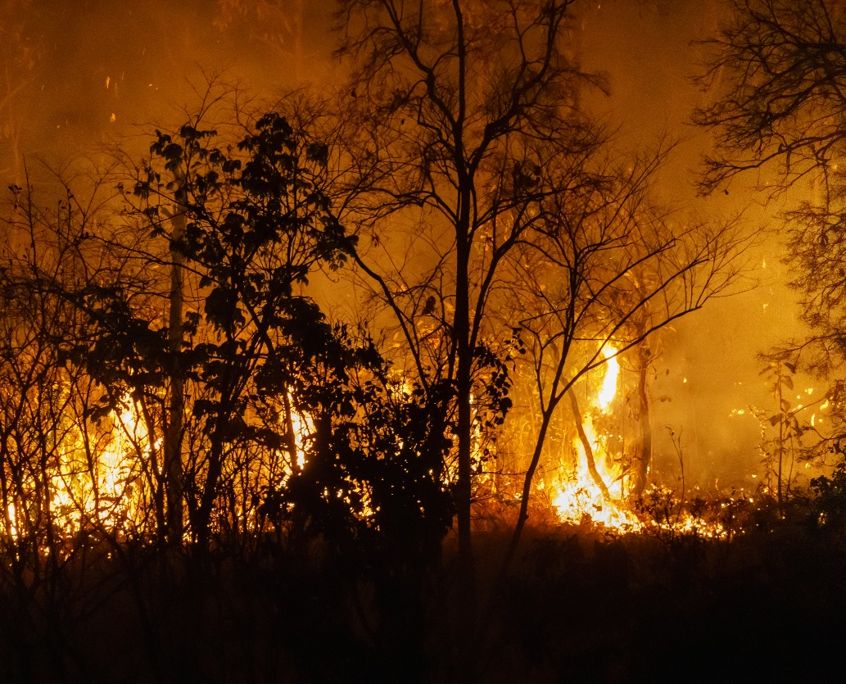
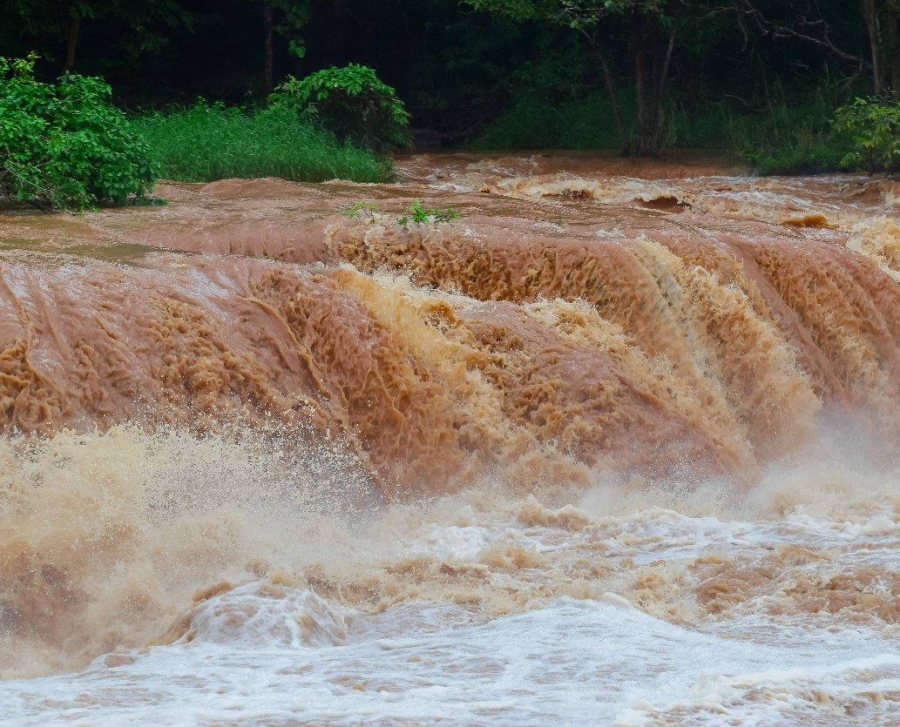
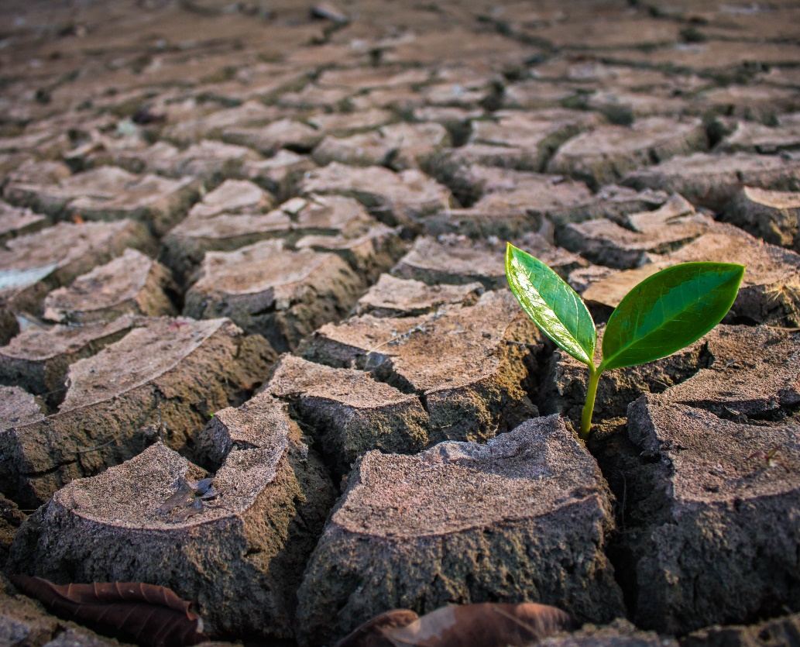

Dramatic Extreme Weather Events
Drought
Increase in
Ocean Temperature
Forest fire
Flood

Slide 6
Food Security Pillar
Availability
Access
Utilisation
Stability
Reduced yields in crop and livestock systems
Yield reductions, changes in farmer livelihoods, limitations on ability to purchase food
Impacts on food safety due to increased prevalence of microorganisms and toxins
Greater instability of supply due to increased frequency and severity of extreme events; food price rises and spikes; instability of agricultural incomes
Reduced yields from lack of pollinators; pests and diseases
Decline in nutritional quality resulting from increasing atmospheric CO₂
Price rise and spike effects on low-income consumers, in particular women and children, due to lack of resources to purchase food
Reduced food quality affecting availability (e.g., food spoilage and loss from mycotoxins)
Widespread crop failure contributing to migration
and conflict
Increased exposure to diarrheal and other infectious diseases due to increased risk of flooding
Disruptions to food storage and transport networks from change in climate, including extremes
Effects of increased extreme events on food supplies, disruption of agricultural trade and transportation infrastructure
Examples of Observed and Projects climate change impacts

Slide 7
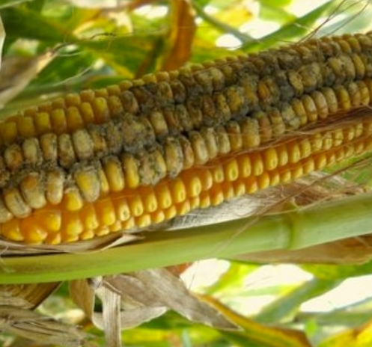
Impact on Crops
Crops Susceptible to Mycotoxin Infections
Aflatoxins (naturally occurring mycotoxins found in corn) are known carcinogens and can also cause impaired development in children, immune suppression, and, with severe exposure, death.
Maize is especially susceptible to mold growth and mycotoxin production.
Other commodities include peanuts, cereal grains and fruit.
Climate change will expand the geographical range where mold growth and mycotoxin production occur
Predicted: Aflatoxin contamination in corn may increase with climate change in Europe ((in specific areas of Spain, Greece, Italy, Bulgaria, Albania and Cyprus)

Slide 8
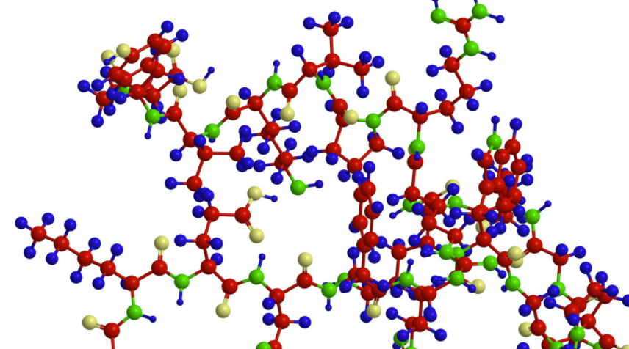
Impact on Crop Nutritional Quality
Quantity of food is an obvious requirement for food security.
Nutritional quality is essential to fulfill basic nutritional needs.
12
Mg
Magnesium
24.305
26
Fe
Iron
55.845
19
K
Potassium
39.098
Impact of rising CO₂ levels:
Protein
Minerals and trace element
Protein content of major food crops is very likely to decline significantly as atmospheric CO2 concentrations increase.
Alteration to the relative proportions of major macronutrients in many crops by increasing carbohydrate content (starch and sugars) while at the same time decreasing protein content.
Very likely to lower the concentrations of essential micro- and macro-elements such as iron, zinc, calcium, magnesium, copper, sulfur, phosphorus, and nitrogen in most plants (including major cereals and staple crops)

Slide 9
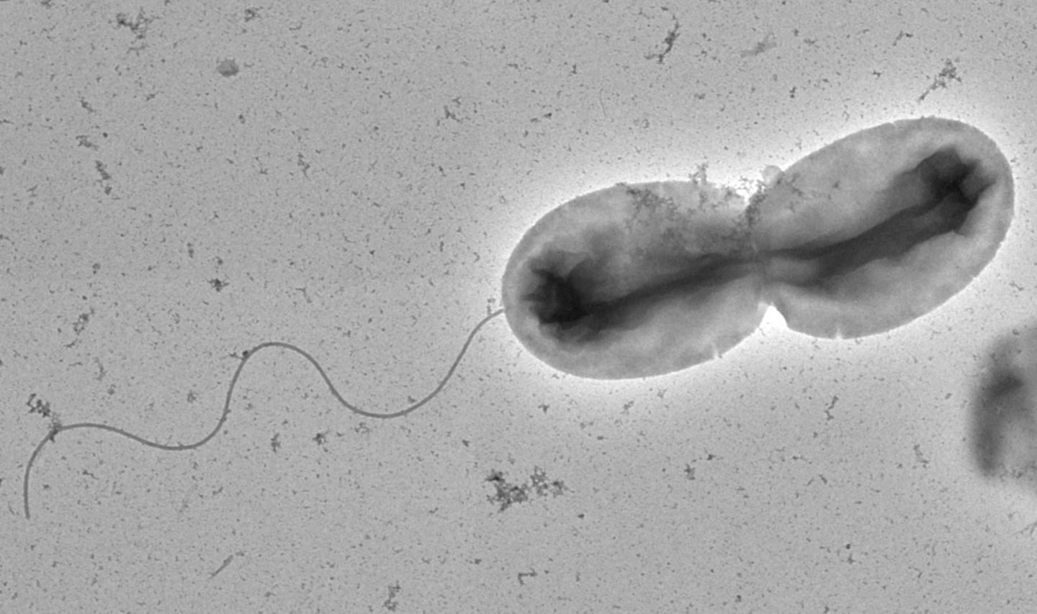
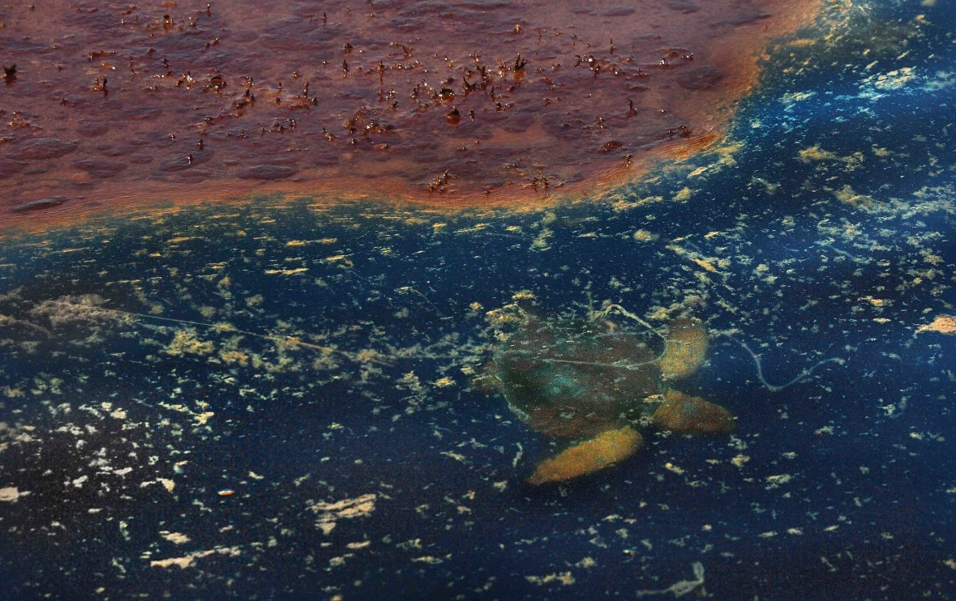
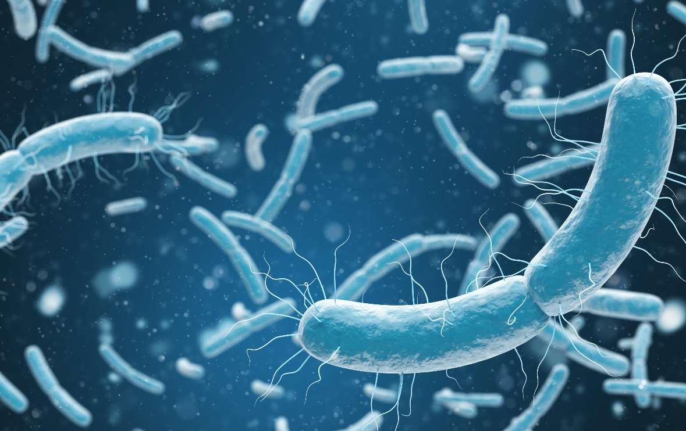
Impact on Microbial Contaminants
Sea surface temperature is directly related to seafood exposure to pathogens
Increased susceptibility of animals to diseases and subsequent faecal shedding of food borne pathogens
Transport of pathogens due to flooding

Slide 10
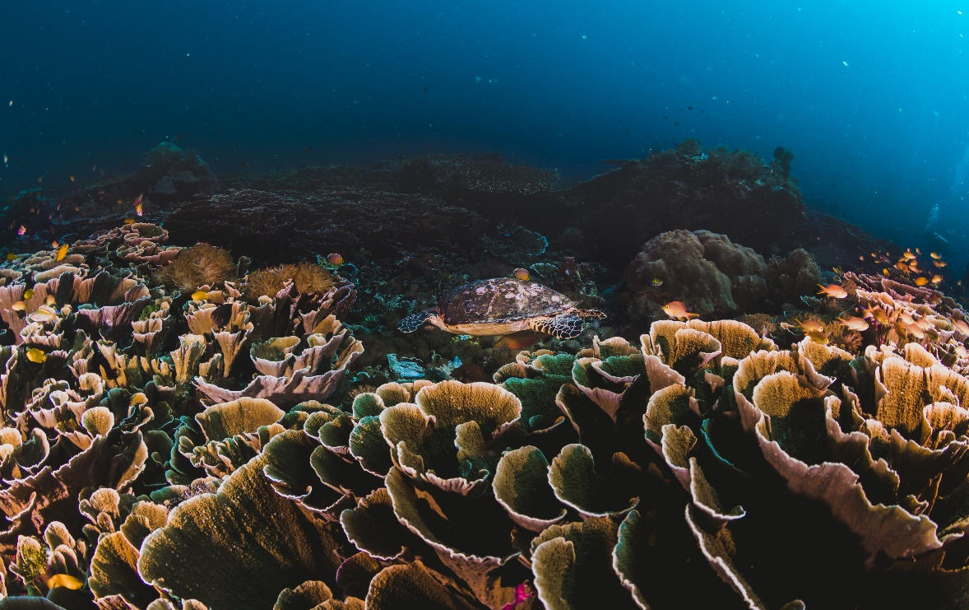
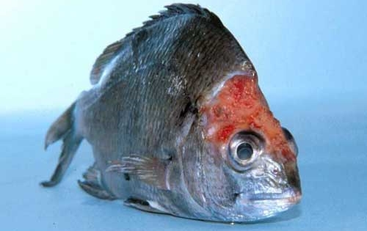
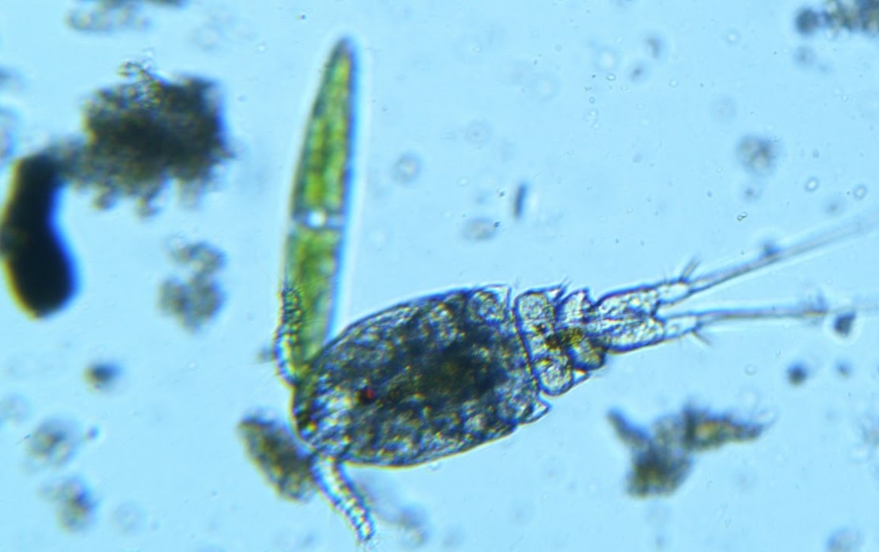
Impact on Chemical Contaminants
Phytotoxins
Elevated sea surface temperatures will lead to greater accumulation of mercury in seafood
Incidence and distribution of pests, parasites, and microbes will alter leading to increases in the use of pesticides and veterinary drugs

Slide 11
Panel Discussion
For these regions
Europe
Are we seeing the impact of Climate change in these regions across globe
West Africa
Middle East North Africa
Saudi Arabia
What's the impact on food safety & security
Africa
Policy Interventions
Notes:
In response to all these impacts which are current and very serious there is a need for policy makers and stakeholders within the food system to adjust their systems, in particular in adjusting their monitoring and surveillance systems to adapt to changing risks.
There is a need to ensure that the food safety infrastructure currently in place within regulators is not only maintained but reviewed and improved. This will require continued investment in surveillance and monitoring of our foods coupled with risk assessment, management and communication.
At this point we take what we head so far and discuss it in the context of what is happening currently in different regions around the world.
We will start with Europe, the West Africa, move across to Middle East North Africa and then across to Saudi Arabia.

